Slide 1
Selling a Single Item with Negative Externalities
To Regulate Production or Payments?
Tithi Chattopadhyay, Nick Feamster, Matheus V. X. Ferreira, Danny Yuxing Huang,
S. Matthew Weinberg

Slide 2
Markets and their negative externalities
Certain markets cause externalities to a third-party.
There is an asymmetry on how effective the seller or the buyer is in mitigating externalities:
Car manufacturers should increase efficiency in reducing greenhouse gas emission.
Buyers of computer devices must use secure passwords to avoid devices being compromised and attacking other services in the internet.
Motivating Questions: Over all possible regulations, which one minimizes negative externalities subject to minimum impact on seller’s profit?
Notes:
Motivating example: sale of IoT devices. Many of which have been compromised for DDoS attacks that disrupted internet-wide services.
Commons: clean air, clean water, internet security and stability

Slide 3
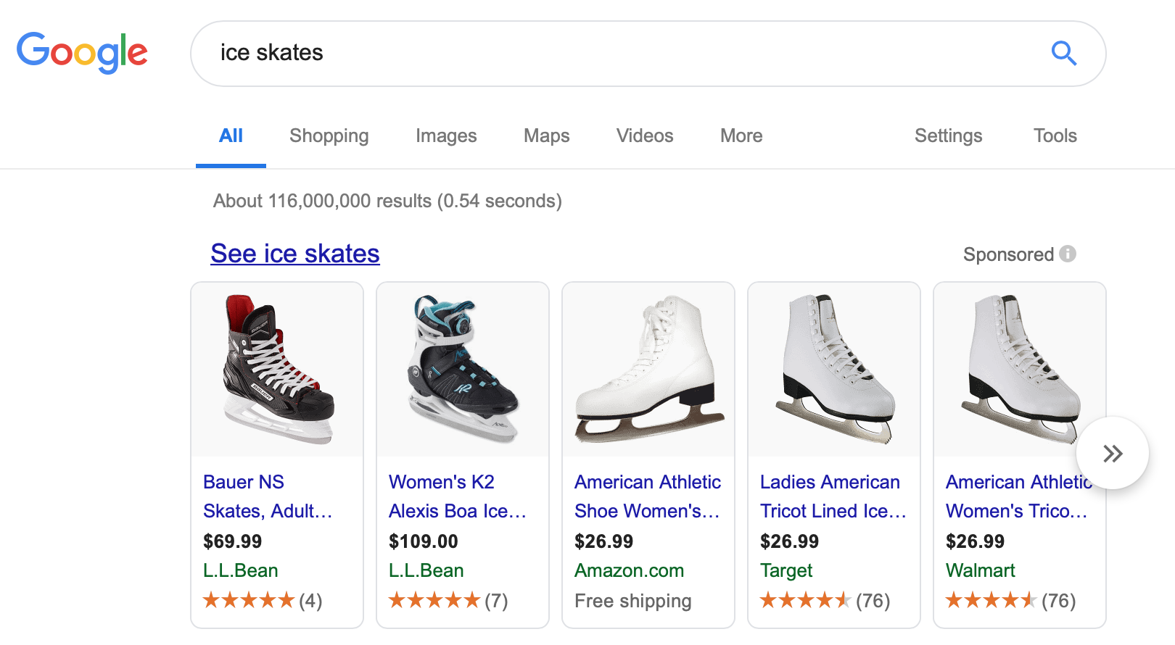
Auctions
Sponsored Search
Selling Items
Spectrum Auctions
Designing an Optimal Auction?
[Myerson’81]: Characterize the optimal price and allocation to maximize revenue in a single-item auction.
[Vickrey ’61, Clarke’ 71, Groves’73]: VCG Mechanism - Truthful and welfare maximizing mechanisms.

Slide 4
Externalities inside the Market
Positive Externalities
Social Networks: the value for a phone increase if friends purchase the same phone Haghpanah, et al. (2013); Hartline, et al. (2008); Mirrokni, et al. (2012); Candogan, et al. (2012).
Negative Externalities
Advertising Auctions: Bhattacharya, et al. (2011).
Selling Innovations: Nuclear Weapons Jehiel, et al. (1996).
Notes:
Advertising: the utility of buyers decrease as more buyers acquire the item
Nuclear Weapons: agents have externalities even if they decide not to participate.

Slide 5
Tragedy of the Commons
The externalities of a market affect common goods (e.g. clean air, security, wireless spectrum access)
Common approach is to regulate the market that is causing externalities
Large body of work Write Down References: [Seabright’93], [Lehr and Crowcroft’05]; [Montero’08]; [Feldman et al.’13]; [Martimort and Sand-Zantman’16]
[Weitzman’74]: Regulate Prices (Taxes, Fines) or Quantities (Minimum Standard) and maximize BENEFITS – COST

Slide 6

The Tragedy of the Commons in Information Security
Software or Hardware provider sell insecure products.
Consumers do not consider or take actions towards reducing security risks due to asymmetric information
Users cannot distinguish secure from insecure devices
[Akerlof’70]: Asymmetric information results in a bad equilibrium (“The market for lemons”)
Vulnerabilities result in harm to third-party services, loss of reputation to sellers and compromise security and privacy of users.

Slide 7
Regulating Prices vs Production
Production: The regulator requires minimum security from seller.
Examples: Healthcare organizations, financial institutions and federal agencies are required to protect their systems and information.
Prices: The regulator penalize users when items cause externalities.
Examples: Taxes or fines where users are made liable for software or devices that are compromised [Kunreuther and Heal`03]. Vendors offer discounts to users who adopt good security practices [August et al.’16].
Notes:
HIPAA, Gramm–Leach–Bliley Act FISMA
Consumers are in best position to avoid many security breaches.

Slide 8
Distribution of Buyers
We consider regulating externalities in a market for single item and single buyer.
Buyer has two parameters (value and efficiency) drawn independently:
Prices and Production regulation are no interchangeable and how effective one is in comparison with the other depends on how efficient the buyer is in decreasing externalities.
Efficiency (k): How efficient a buyer is in securing the device where k >> 1 is very efficient and k < 1 is inefficient
Some buyers are more efficient than others.
Depends on the application domain (IoT devices, technology, Oil licensing, etc…).
Value (v): How much the buyer values the item when there is no externalities and no regulation.
Notes:
Our O(1)-approximation for simple policies has no assumptions.

Slide 9
Externality
Seller has an investment c towards security.
Buyer spends effort h securing the item.
Externalities are modeled as the probability of a device being compromised.
Externalities are model as a exponentially decreasing quantity because reducing risk becomes harder as the investments increase.
Buyer’s Efficiency
Seller’s Effort
Buyer’s Effort
Probability of an Externality

Slide 10
Regulation
A regulation is a combination of minimum security investments for the seller and fines to the buyer.
Regulating Production: mandatory security investment c (equivalent to seller’s cost).
Regulating Prices: buyer receives a fine y if device is compromised.
Can be indirect economic incentives: insurance, discounts.
Seller’s price p.
A regulation is simple if either c = 0 (fine policy) or y = 0 (cost policy).
[Weitzman’74]: Study which simple policy is optimal for welfare maximization.
Regulation:

Slide 11
How regulation affects buyer’s utility
Buyer’s Effort
The fine y induces the buyer to adopt security practices.
Buyer’s Penalty
Price
Buyer’s Utility
Optimal Buyer’s Effort
Buyer’s Externality under Optimal Effort
We model externalities as the expected risk conditioned on purchases.

Slide 12
How regulation affects seller’s profit
Regulating prices y, decreases buyer’s utility which decrease their probability of purchasing the item.
Regulating production c, decreases seller’s net profit per sale
Optimal profit for different combinations of regulation:

Slide 13
Defining the Optimal Regulation
Any regulation directly or indirectly affects buyer’s profit. To minimize the impact on seller, we constrain on regulations that provide minimum profit R.
Def (Optimal Regulation):
Minimum Profit of $3

Slide 14
Example (Regulating Production is Optimal)
Assume any value distribution D, efficiency distribution with all density in 0 and some regulation s = (y, c, p)
Buyer is Inefficient in Reducing Externalities
It is in buyer’s best interest to never put in effort to reduce externalities since any effort h > 0 has no impact on externalities
Externality only depends on the seller’s effort
Any price regulation y > 0 can only hurt buyer’s
utility and has no impact on externality
The externality of the population only depends on seller’s investment
Conclusion: Since any fine y > 0 can only hurt revenue and has no impact on externalities. The optimal regulation only regulates production.

Slide 15
When Regulating Only Production is Optimal?
Theorem: For all value distributions V, and profit constraint R, there is a cutoff T = T(V, R) such that for all efficiency distribution K supported on [0, T(V, R)], regulating quantities is optimal.
Let s be the optimal regulation on a point mass on T where s regulates only quantities.
Since y = 0, the buyer’s utility does not depend on the efficiency distribution.
Since s is feasible (and optimal) on a point mass on T, then s is feasible on K.
Suppose for contradiction s’ is a better regulation on K, then s’ is a better regulation on {T}
s must be optimal on K
Increasing efficiency can only decrease externality
Because s regulates only quantities, externalities do not depend on the distribution

Slide 16
What about distributions supported above the cutoff?
Def (Profit-Maximizing): A regulation s = (y, c, p) is profit-maximizing if the price is a best-response to the seller.
There is an instance (V x K, R) where the optimal policy is not simple even though K is supported on [T(V, R), ∞). Such policies are not profit maximizing.
If K is a point mass and K = 3 the optimal regulation regulates only production and for K > 3 the optimal regulation regulates only prices.

Slide 17
What about distributions supported above the cutoff?
Consider the following uniform distribution over buyers:
Profit constraint R = 1/2
Externalities are affected by the population that purchase. The optimal regulation can reduce externalities by forcing inefficient buyers out of the market
(v, k):
(1, 3)
(16/15, 3)
(1, x)
(16/15, x)
Efficient Buyers
Selling only (1, x) and (16/15, x) is not feasible (Price < 1 and sell with probability ½)
Selling to everyone implies the optimal regulation is the same regulation as if everyone had efficiency 3
Selling to everyone but (1, 3), price must be at least 2/3 (Prob. of sale is ¾). This limits how big fines can be; which
implies the optimal regulation is mixed between fines and quantities.

Slide 18
When Regulating Only Prices is Optimal?
The optimal regulation charges price 1 - ε to not sell to (1, 3) and is a mix between fines and cost.
Remark: such regulations is not profit-maximizing. Even though the regulation achieves the minimum profit of ½, a seller willing to maximize profit will sell at a lower price 14/15 so that (1, 3) purchase giving higher profit.
(v, k):
(1, 3)
(16/15, 3)
(1, x)
(16/15, x)
Theorem: For all value distributions V and profit constraint R, there is a cutoff T = T(V, R) such that for all efficiency distributions K supported on [T, ∞], the optimal regulation regulates only prices or it is not profit-maximizing.

Slide 19
Can simple regulations approximate mixed regulations?
Recap: a simple regulation regulates only prices or only production.
Hope for an approximation: externalities increase by at most a constant factor.
Answer:
No, if we are not willing to relax the profit constraint R.
Yes, if we are willing to relax the profit constraint Ω(R).
Simple regulation
Some arbitrary regulation

Slide 20
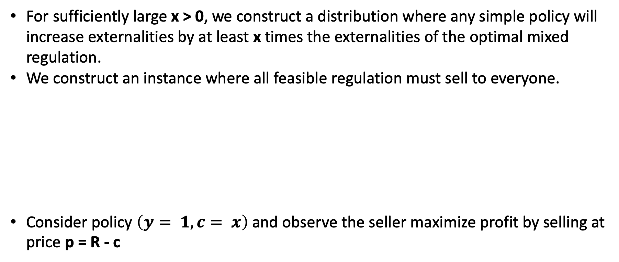
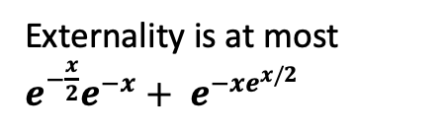
Constructing a bad distribution
For sufficiently large x > 0, we construct a distribution where any simple policy will increase externalities by at least x times the externalities of the optimal mixed regulation.
We construct an instance where all feasible regulation must sell to everyone.
Consider policy $\left(y= 1, c= x\right)$ and observe the seller maximize profit by selling at price p = R - c
Maximum revenue by not selling to everyone
Everyone purchase and the profit is R
Externality is at most $e^{−\frac{x}{2}}e^{−x}+ e^{−xe^{x/2}}$

Slide 21
Constructing a bad distribution
The highest cost for a cost policy is $x + e^{−x}$ (externality at least $e^{−x−1}$)
Optimal price is equals to the only possible value since buyer’s utility does not depend on their efficiency when y = 0
The highest fine for a fine policy is $x + e^{−x}$ (externality is at least $e^{−x/2}$)
Since we must sell to everyone, we must sell to the buyer with efficiency 0
However, the mixed regulation with y = 1, c = x has externalities at least x times smaller

Slide 22
Relaxing the profit constraints towards an approximation
The previous example shows that if the profit constraint cannot be violated we cannot hope for any approximation with simple regulations.
Profit when only Alice purchase:
The inefficient buyer has a negligible contribution to profit. Losing a small fraction of the profit by not selling to the inefficient buyer greatly improve externalities of regulating only prices

Slide 23
Bicriteria Approximation: Regulating the population that purchase
Given some arbitrary regulation s, we will construct a simple regulation s’ targeting the population that already purchase the item under regulation s. This new regulation can potentially decrease profit; however, we can guarantee that we still get a constant fraction of the old profit.
Efficiency distribution of buyers that purchase
Buyers that have efficiency k > 1 and put in effort h > 0
Buyers that put in no effort h = 0
Buyers that have efficiency k ≦ 1 but put in effort h > 0

Slide 24
Simple Regulations in Region 1
If a large fraction of the population does not put in effort then removing fines will have small effect on externalities.
Region 1
Region 3

Slide 25
Simple Regulations in Region 2
The externalities on region 2 are at least
However, if y >> c, the same strategy of region 1 would fail.
We claim then:

Slide 26
Simple Regulations in Region 2
If , we reach a contradiction because the probability of sale would be too big

Slide 27
Simple Regulations in Region 3
In this case, simple regulations can either regulate only production or only prices.
In the first step, we blowup fines preserving constant fraction of the sales:
The goal is to decrease utility of inefficient buyers and reduce externalities
Bad cases:
If K has small expected value, then we are unable to induce a large blowup.
If V is heavy tail we cannot drive inefficient buyers out of the market.
In the bad cases, we can derive cost policies that have good externality guarantees.

Slide 28
Example (The Optimal regulation depends on the value distribution)
Assume the buyer has value drawn from the equal revenue distribution which is heavy-tail and fix some regulation s = (y = 0, c, p)
Equal Revenue
For every profit constraint R < 1, for every externality target E there is a regulation (y = 0, c > 0) that gets revenue > R and externality < E.
In this example, the optimal regulation does not converge to a finite value because the buyer’s value has infinite expected which can be converted to reduce externality.

Slide 29
Open Questions
Can the approximation rations be improved?
It is not clear how to get better than ½ profit approximation even when we are ok in having higher externalities.
Considering competing sellers and multiple items.

Slide 30

Questions?

